Slide 1


School of Basic and Applied Sciences
Course Code: BBS01T1002 Course Name: Semiconductor Physics
Effect of temperature and carrier concentration on Fermi level
Name of the Faculty: Dr. Aakash Mathur Program Name: B.Tech

Slide 2
Topics to be covered
Variation for Fermi level with temperature
Variation for Fermi level with carrier concentration
Practice questions

Slide 3
Prerequisite/Recapitulations
--
Knowledge of:
Energy band diagram for P and N type semiconductor
Density of energy state in semiconductor
Fermi energy level

Slide 4


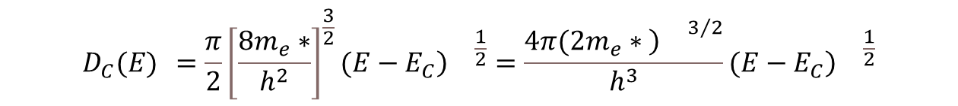
Prerequisite/Recapitulations
--
The density of allowed electronic energy states in the conduction band is given by generalising the results for free electron model;
$$Z^{′}(E) =\frac{π}{2}{\left[\frac{8m}{h^{2}}\right]}^{\frac{3}{2}}E^{\frac{1}{2}}$$
In case of semiconductors, the expression of density of state for conduction band is
$$D_{C}(E) =\frac{π}{2}{\left[\frac{8m_{e}∗}{h^{2}}\right]}^{\frac{3}{2}}(E−E_{C}{\left)\right.}^{\frac{1}{2}}=\frac{4π(2m_{e}∗{\left)\right.}^{3/2}}{h^{3}}(E−E_{C}{\left)\right.}^{\frac{1}{2}}$$
Similarly we may then generalize the density of states function to apply to the valence band, so that
$$D_{v}(E) =\frac{4π(2m_{h}∗{\left)\right.}^{3/2}}{h^{3}}(E_{v}−E{\left)\right.}^{\frac{1}{2}}$$

Slide 5
Objectives
After the completion of the lecture you will be able to:
explain the variation of Fermi level with temperature
explain the variation of Fermi level with carrier concentration

Slide 6
Introduction
Charge Carrier Density in intrinsic semiconductors: The distribution (with respect to energy) of electrons in the conduction band is given by the density of allowed quantum states times the probability that a state is occupied by an electron. We may express this as ;
n(E)=f(E)Dc(E) dE
where f (E) is the Fermi-Dirac probability function and Dc(E) is the density of quantum states in the conduction band. The total electron concentration per unit volume in the conduction band is then found by integrating above equation over the entire conduction-band energy.
Similarly, the distribution (with respect to energy) of holes in the valence band is the density of allowed quantum states in the valence band multiplied by the probability that a state is not occupied by an electron. We may express this as p(E)= Dv(E) (1-f(E)) dE ; here Dv(E) is the density of quantum states in the conduction band The total hole concentration per unit volume is found by integrating this function over the entire valence-band energy.

Slide 7

Derivation of n and p from D(E) and f(E)
First, we will derive the concentration of electrons in the conduction band, known
as the electron concentration. Since Dc(E) dE is the number of energy states
between E and E + dE for each cubic centimeter, the product f(E)Dc(E) dE is then
the number of electrons between E and E + dE per cubic centimeter of the
semiconductor. Therefore, the number of electrons per cubic centimeter in the
entire conduction band is

Slide 8
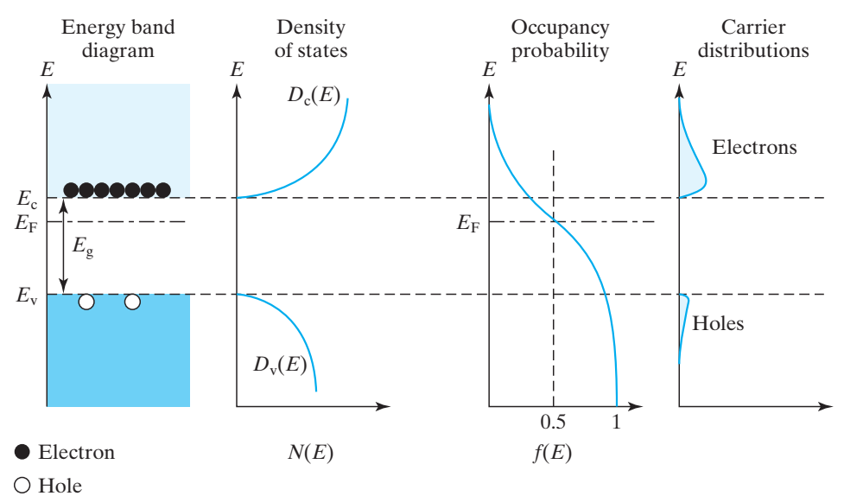
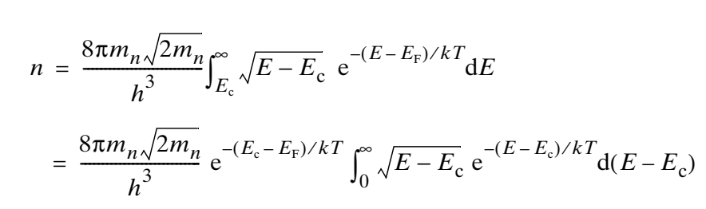
Derivation of n and p from D(E) and f(E)
Graphically, this integration gives the shaded area in Fig, which yields the density of electrons.
Schematic band diagram, density of states, Fermi–Dirac distribution, and carrier distributions versus energy.

Slide 9



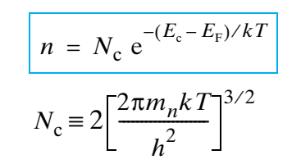
Derivation of n and p from D(E) and f(E)
Introducing a new variable
reveals that the integral in Eq is of a form known as a gamma function and is equal to
Thus the equation becomes
Nc is called the effective density of states in conduction band .

Slide 10
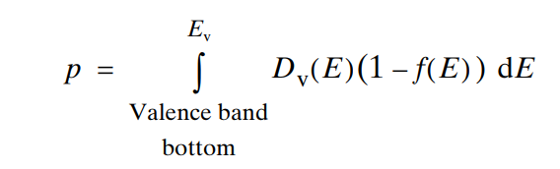
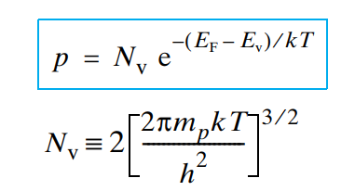
Derivation of n and p from D(E) and f(E)
An expression for the hole concentration can be derived in the same way. The probability of an energy state being occupied by a hole is the probability of it not being occupied by an electron, i.e., 1– f (E). Therefore,
The values of Nc and Nv, both about 10¹⁹ cm^{–3}, differ only because mn and mp are different.
Therefore the expression for hole concentration is:
Nv is the effective density of states of the valence band

Slide 11

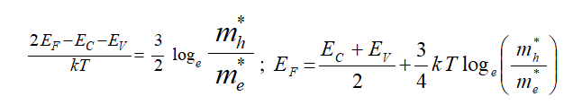
Fermi level in Intrinsic Semiconductor
For an intrinsic semiconductor n_{e} = n_{h} = n_{i}
Strictly speaking the effective mass of electron m_{e}* is different than that of a hole m_{h}* but to a good approximation m_{e}* and m_{h}* may be assumed to be equal and so eqn. reduces to
This shows that in an intrinsic semi-conductor, the Fermi-level essentially lies at the centre of the forbidden energy gap E_{g}.
Taking log on both the sides, we get

Slide 12
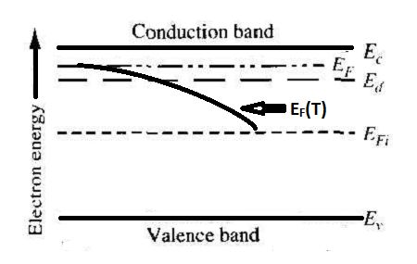
Fermi level variation with temperature in Extrinsic Semiconductor
In n-type semiconductor: At 0 K all allowed energy levels in the valence band are filled by electrons. All donor levels are filled by unbound electrons. The conduction band is free. So charge carriers do not exist, and the semiconductor behaves as an insulator. At 0 K the Fermi level is between the donor levels and the bottom of the conduction band as shown below.
Energy level diagram of N-type semiconductor. E_{F}(T) shows the effect of temperature on Fermi energy

Slide 13
Fermi level in Extrinsic Semiconductor
When the temperature is raised, by absorption of suitable energies, some donor atoms are ionised, so that their electrons are elevated to the conduction band. If the density of ionised donor atom is N_{d} and the density of electron-hole pairs in the intrinsic semi-conductors is n_{i} at room temperature T, then N_{d} >> n_{i}. The Fermi energy is given by
This shows that in an N-type semiconductor the Fermi-level lies below the bottom of the conduction band. As temperature rises, the Fermi level goes on falling below E_{C}. When the temperature is sufficiently raised, the electrons and holes generated due to thermal agitation increase significantly and at a stage become fully dominant over the extrinsic carriers. Then the Fermi level approaches the middle of forbidden energy gap.
where N_{C} = 2

Slide 14
Fermi level variation with temperature in Extrinsic Semiconductor
In P-type semiconductor: The energy band diagram of a P-type semiconductor is shown in the Figure. The acceptor level is shown by E_{a} near the top of the valence band, the Fermi level by E_{F}. At absolute zero, all the holes are in acceptor levels, but as the temperature rises, the electrons from valence band jump into acceptor level on the absorption of energy (E_{A}-E_{V}) by each electron. As a result, these electrons are trapped in the acceptor levels and an equal number of holes are created in the valence band. These holes provide conduction currents. At the room temperature, almost all acceptor atoms trap electrons and thus the number of holes available in the valence band is almost equal to the number of impurity atoms added.

Slide 15

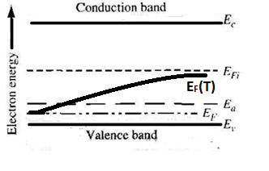
Fermi level variation with temperature in Extrinsic Semiconductor
The variation of Fermi energy with temperature is given by:
This shows that Fermi level lies above the top of the valence band. The position of Fermi level depends upon the temperature and the number of impurity atoms. When the number of impurity atoms increases, the number of holes in the valence band will increase and the Fermi level will shift towards the valence band. When the concentration of acceptor impurity atoms is sufficiently high, the number of holes will be far greater than the conduction electrons and the Fermi level may even lie in the valence band. As the temperature is sufficiently increased, electrons from the valence band are excited to the conduction band and finally the P-type crystal will start behaving like an intrinsic semi-conductor when the number of electrons in the conduction band will be nearly equal to the valence holes. Thus at extremely high temperatures the Fermi level shifts towards the middle of forbidden energy gap.
Energy diagram of P-type Semiconductor. E_{F}(T) shows the effect of temperature on Fermi energy.

Slide 16
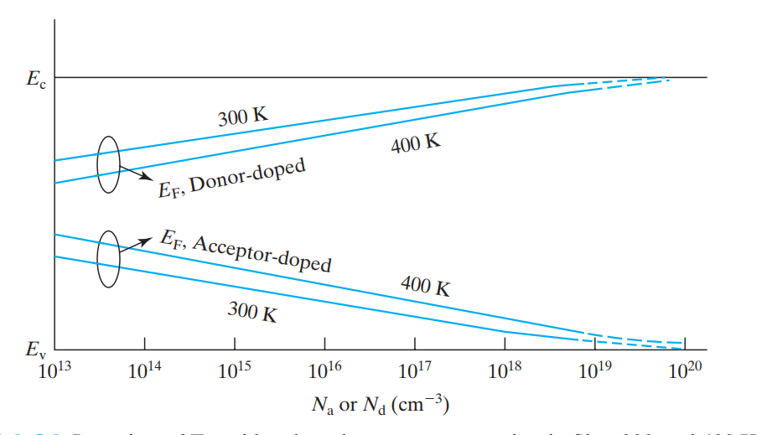

Fermi level variation with doping concentration in Extrinsic Semiconductor
Figure shows the location of the Fermi level as a function of the carrier concentration. Note that the solid lines stop when EF is about 20 meV (~kT) from Ec or Ev
Location of Fermi level vs. dopant concentration in Si at 300 and 400 K.

Slide 17
Practice Questions
Derive the Fermi energy expression for intrinsic semiconductor
Derive the Fermi energy expression for extrinsic semiconductor
Draw the graph for Fermi energy variation with temperature for extrinsic semiconductor
Draw the graph for Fermi energy variation with doping concentration for extrinsic semiconductor

Slide 18
References:
1. J. Singh , Semiconductor optoelectronics, Physics and Technology, Mc-Graw –Hill Inc. 1995.
2. S.M. Sze, Semiconductor Devices: Physics and Technology, Wiley 2008.
3. Pillai S O, Solid State Physics,( 2010), sixth edition, New Age International (P) Ltd. ISBN-9788122427264.
4. M.N. Avadhanulu and P.G. Kshirsagar, A Text book of Engineering Physics-, 10th
revised Ed, S. Chand & Company Ltd, New Delhi

